Slide 1
THE SIXTH MASS EXTINCTION
BIODIVERSITY CONSERVATION AND UTILIZATION
GROUP 4

Slide 2
OUTLINE
Introduction
Definition of mass extinction
Current mass extinction
Causes of mass extinction
Impacts of mass extinction
Biodiversity conservation efforts and strategies
Conclusion

Slide 3
Introduction
Mass extinction refers to a significant and rapid loss of species occurring over a short period. It leads to a decline in biodiversity across various groups of organisms.
The concept of the sixth mass extinction refers to an ongoing period of significant biodiversity loss on earth. It is often described as a current event characterized by a rapid decline in species populations and an elevated extinction rate compared to natural background extinction rate.

Slide 4
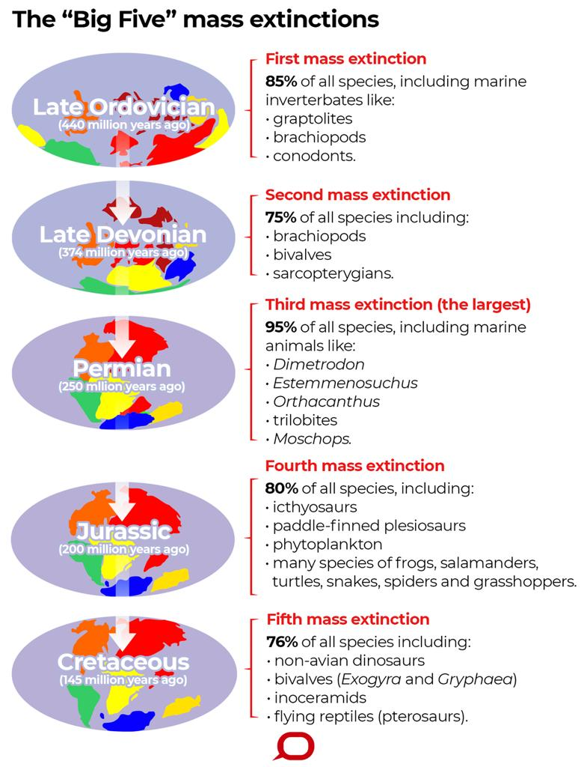
Previous mass extinction
Fig a

Slide 5
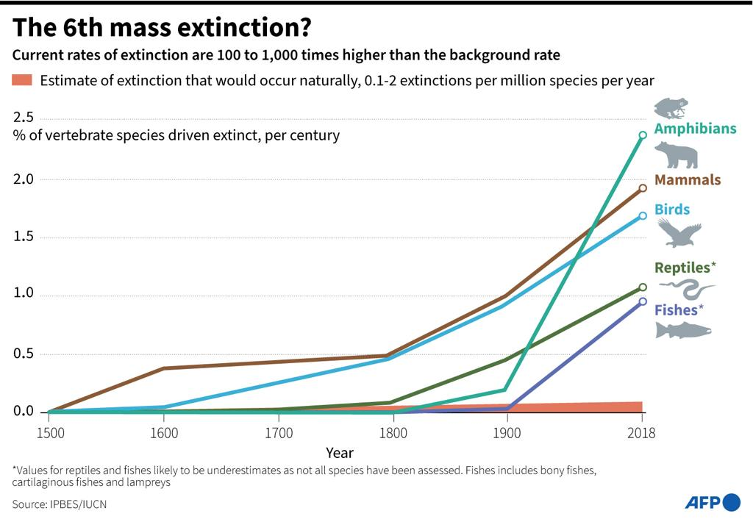
Distinguishing characteristics between previous extinctions and the current one.
Rate of species loss.
The cause of the extinction.
Areas affected.
Predictability.
Fig b

Slide 6
Causes of SIXTH mass extinction
Habitat loss and fragmentation: Every year, around 18.7 million acres (7.6 million hectares) of forest are lost, equivalent to roughly 27 soccer fields per minute
Climate change: It is projected that a temperature increase of 1.5 to 2 degrees Celsius could put 20-30% of species at risk of extinction

Slide 7
Causes of SIXTH mass extinction
Pollution: Each year, approximately 8 million metric tons of plastic end up in the oceans, endangering marine life and ecosystems.
Overexploitation and illegal Wildlife Trade: According to the WWF, global wildlife populations have declined by an average of 68% since 1970

Slide 8
Causes of SIXTH mass extinction
Invasive species: In the United States alone, invasive species are responsible for an estimated $120 billion in damages and control costs each year

Slide 9
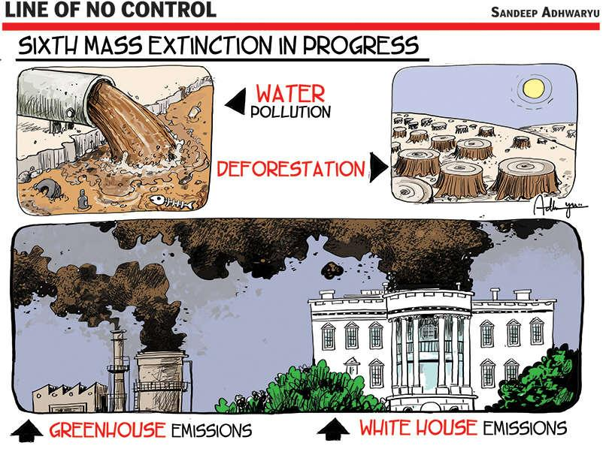
SIXTH MASS EXTINCTION IN PROGRESS
Fig c

Slide 10
Impacts of SIXTH mass extinction
Biodiversity loss.
Ecosystem loss.
Altered ecological niches.
Loss of ecosystem services.
Economic and societal implications.
Long-term evolutionary impact.

Slide 11
Biodiversity conservation efforts and strategies
Protected areas and habitat conservation.
Species recovery and breeding programs.
Conservation of key ecosystems.
Sustainable resource management.
Community engagement and local involvement.
International collaboration and agreements.
Public awareness and education.
Support sustainable agriculture.
Engage in citizen science

Slide 12
conclusion
The sixth mass extinction which is mainly caused by mankind is a pressing crisis that needs immediate action. Human activities are driving the decline in biodiversity, causing disruption to ecosystems and endangering lives on the planet Earth. Through the various conservational efforts and strategies, we can however, make a difference. Biology is about LIFE, let us PROTECT LIFE.

Slide 13
references
Ceballos, G., Ehrlich, P.R., & Dirzo, R. (2017). Biological annihilation via the ongoing sixth mass extinction signaled by vertebrate population losses and declines. Proceedings of the National Academy of Sciences, 114(30), E6089-E6096.
Pimm, S.L., Jenkins, C.N., Abell, R., Brooks, T.M., Gittleman, J.L., Joppa, L.N., ... & Sexton, J.O. (2014). The biodiversity of species and their rates of extinction, distribution, and protection. Science, 344(6187), 1246752.
Barnosky, A.D., Matzke, N., Tomiya, S., Wogan, G.O., Swartz, B., Quental, T.B., ... & Ferrer, E.A. (2011). Has the Earth's sixth mass extinction already arrived? Nature, 471(7336), 51-57.
Dirzo, R., Young, H.S., Galetti, M., Ceballos, G., Isaac, N.J., & Collen, B. (2014). Defaunation in the Anthropocene. Science, 345(6195), 401-406

Slide 14
THANK YOU

